Slide 1

SWITZERLAND, GERMANY, FRANCE,ITALY
LIFE IS FILLED WITH MANY ADVENTURES AND YOUR EXPERIENCES ARE PERSONAL AND THEY MAKE YOU WHO YOU ARE

Slide 2
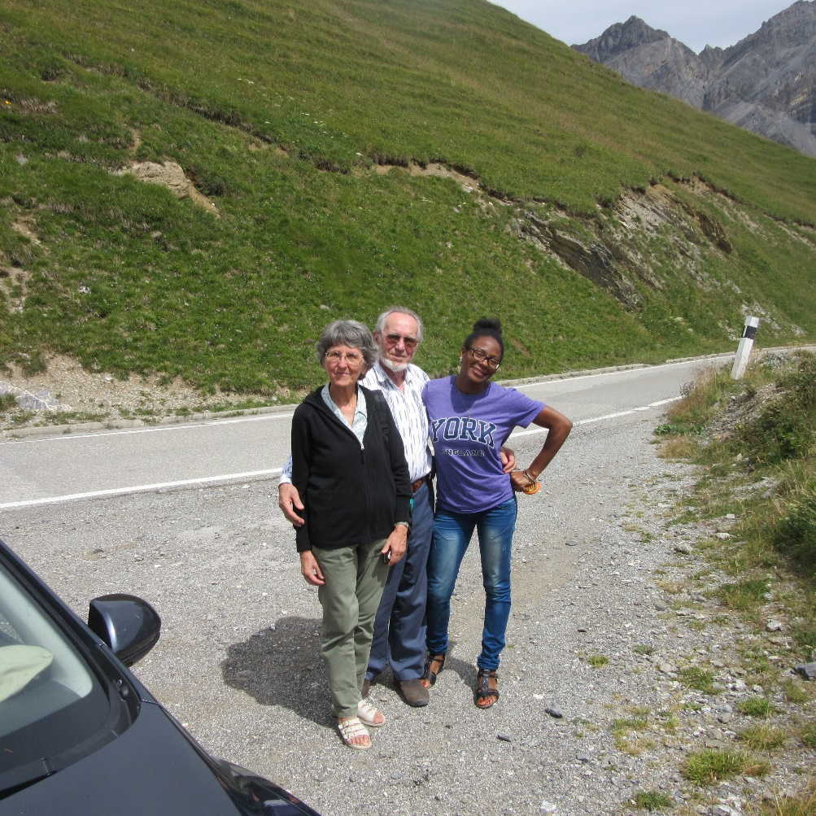
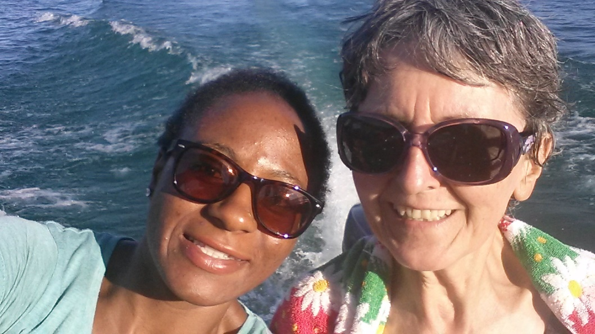
ENJOY THE TOUR

Slide 3
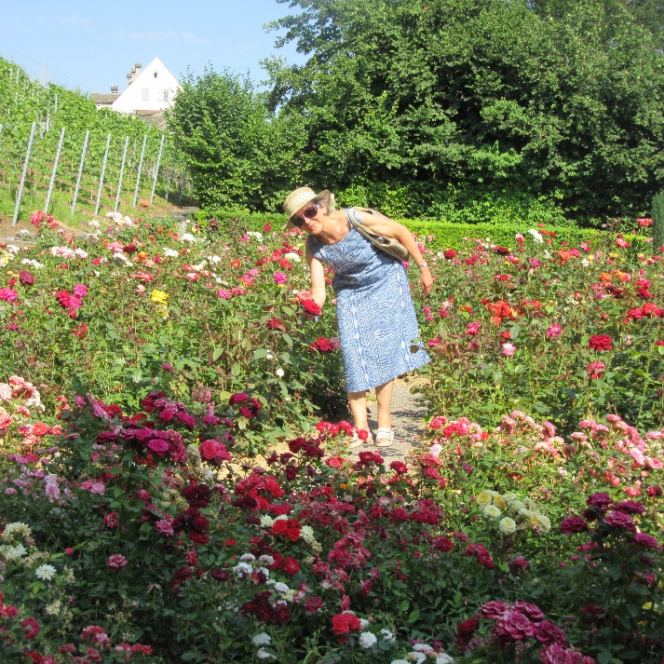
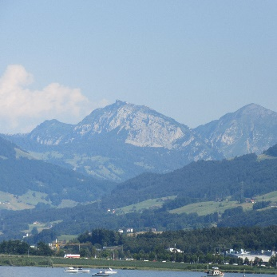
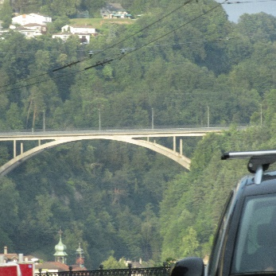
SWITZERLAND
Have you seen the Swiss Alps? Did you see the beautiful rivers and mountains? Isn’t need just gorgeous? Don’t you like it here? Why do you want to return home? Endless questions about a country that’s beautiful, but not mine.
Switzerland is beautiful with many historical and touristic sites. What I saw and did was my adventure, and no two different people can have the same experience as another seeing the same thing.

Slide 4
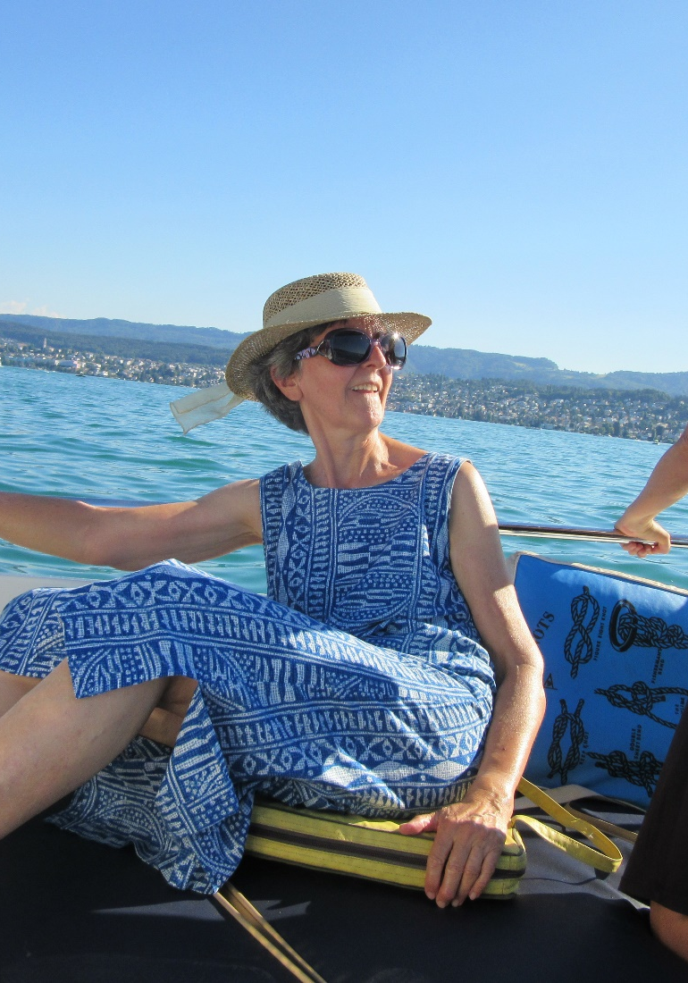
BOAT RIDES
Swiss lakes are beautiful, fun to swim in and go for boat rides if you can afford one. Having friends and family members to enjoy those adventures with you are the greatest gifts ever.

Slide 5
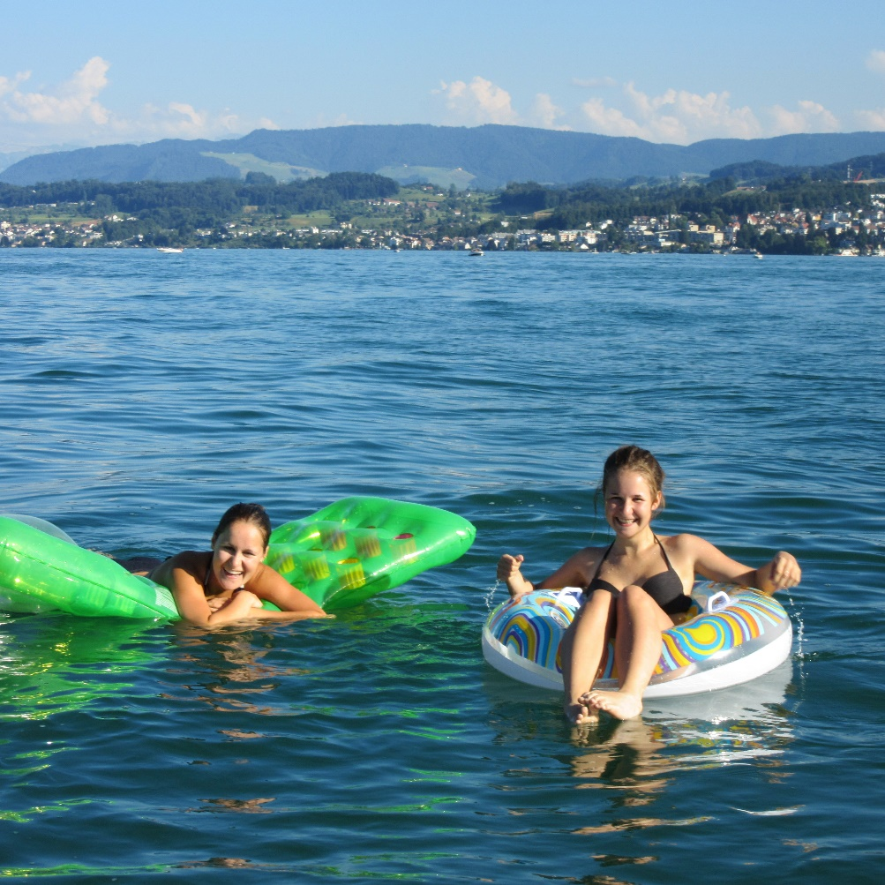
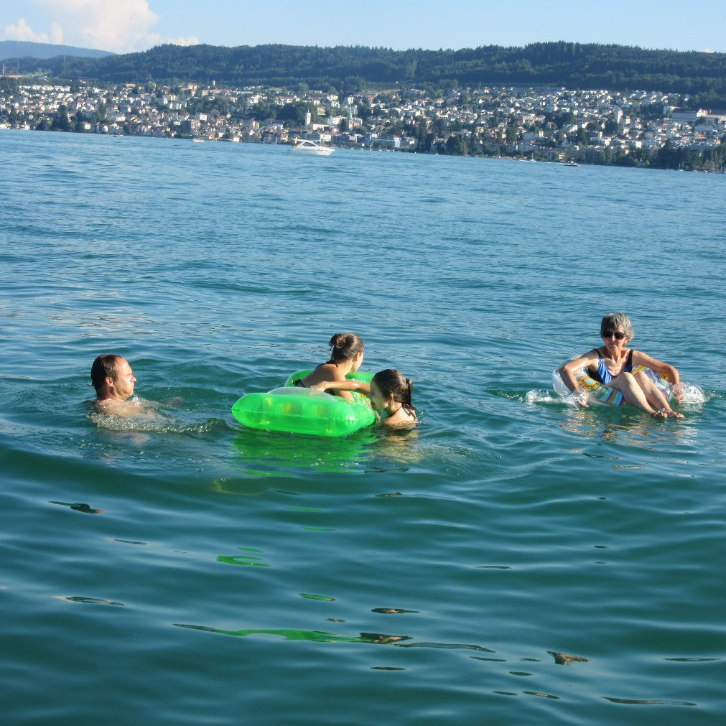
NINI’S FAMILY

Slide 6
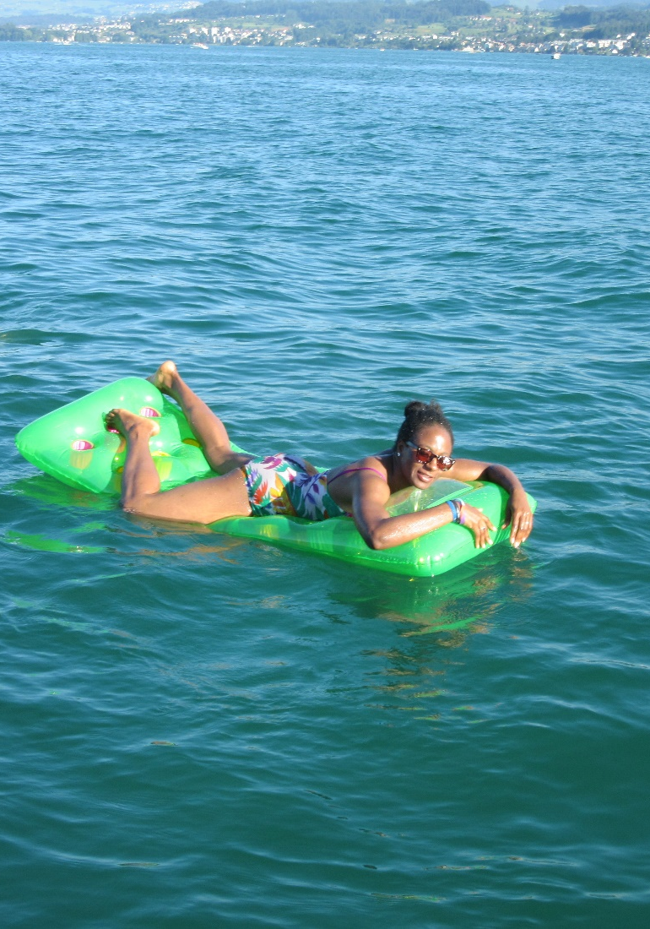
IT’S NOT FORBIDDEN
Just being able to swim in the lake even for a 20 mins was a gift in the deep areas.

Slide 7
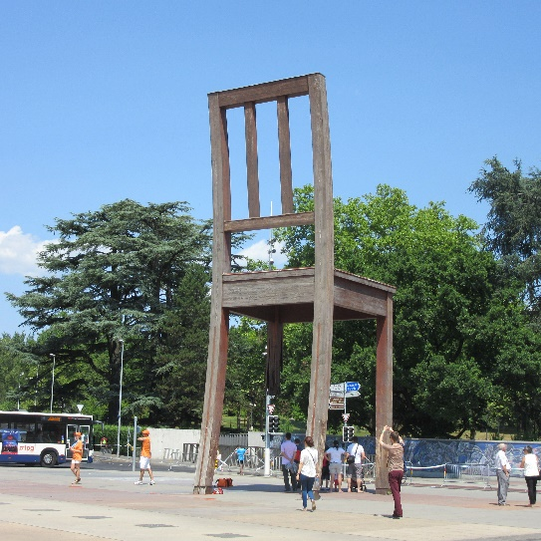
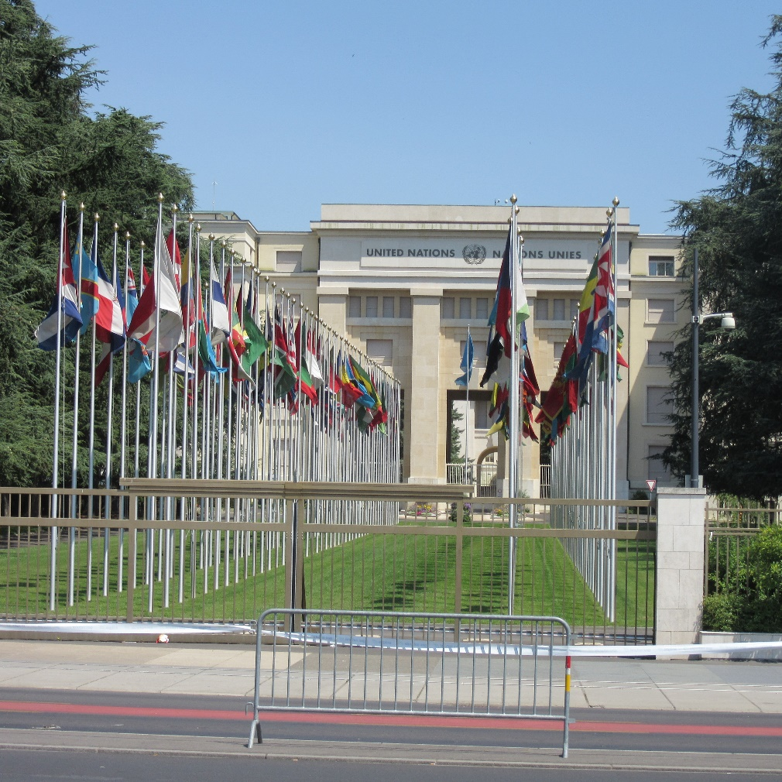
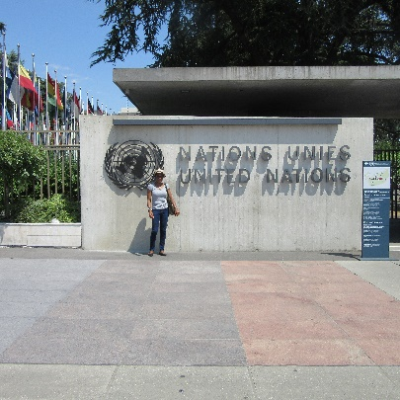
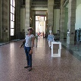
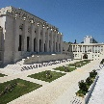
UN HEADQUARTERS, GENEVA

Slide 8
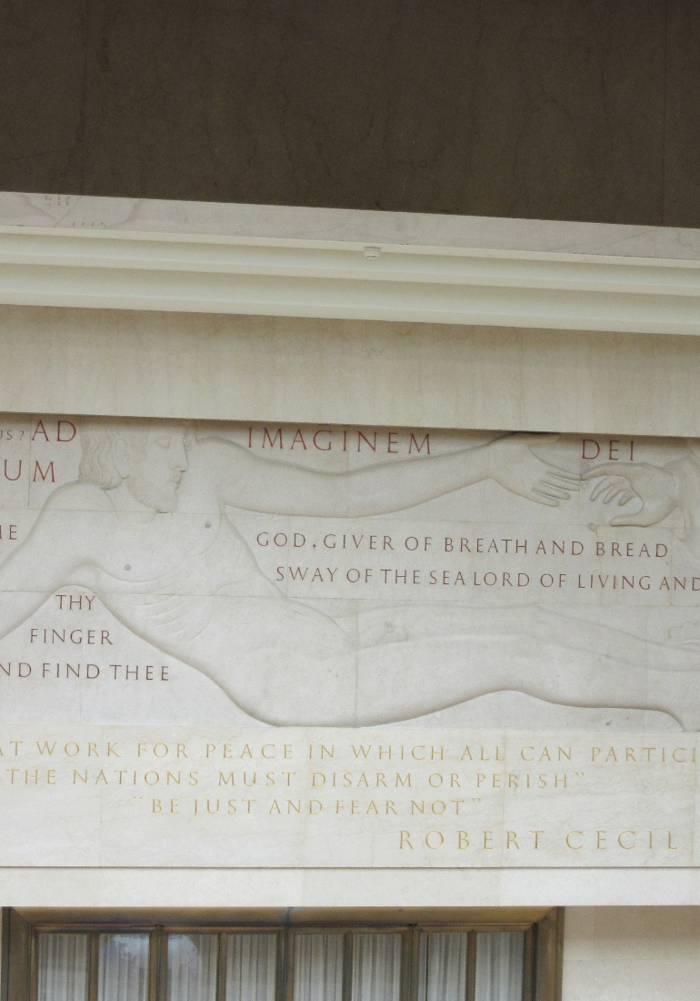
GOD IN THE MIDDLE
Walking through the UN headquarters, I had no expectation of any references to God, due to my experiences with studies in Europe and the understanding that the UN has no religious affiliation.
Well I must say that God really did get me there. GOD, GIVER OF BREATH AND BREAD SWAY OF THE SEA LORD OF LIVING AND DEAD.

Slide 9
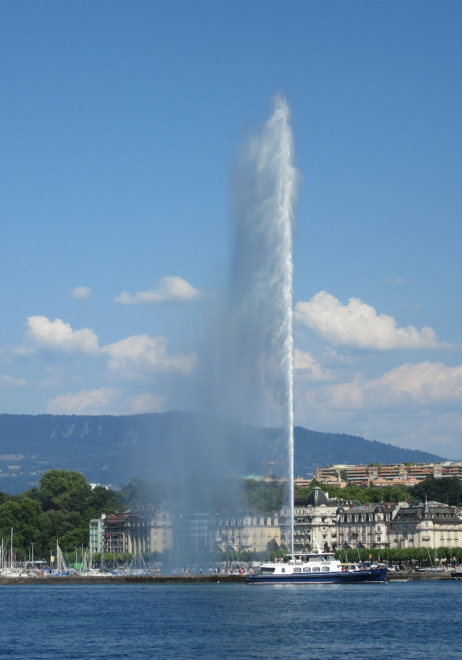
JET D’EAU
Too many wonderful sites to visit and see in Geneva. It’s one of the tallest

Slide 10
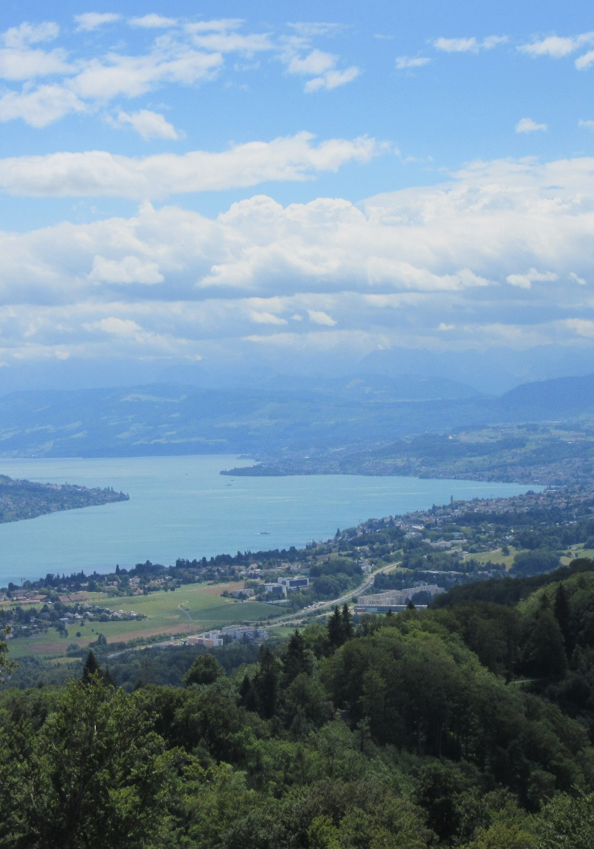
HIGHER LEVELS
High places are sometimes wonderful places to stand on, because they give you and overview of what your circumstance is like. While living in a situation, you are only able to discern what you can see with your eyes without looking at it from different angles.

Slide 11
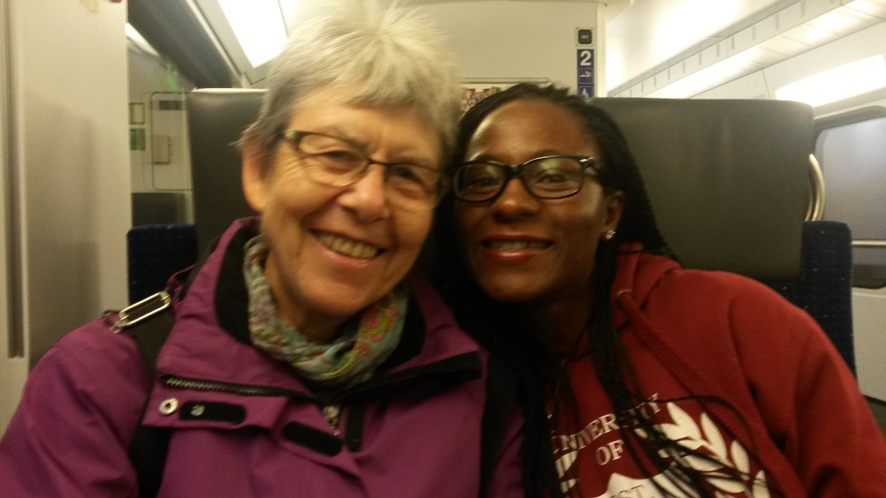
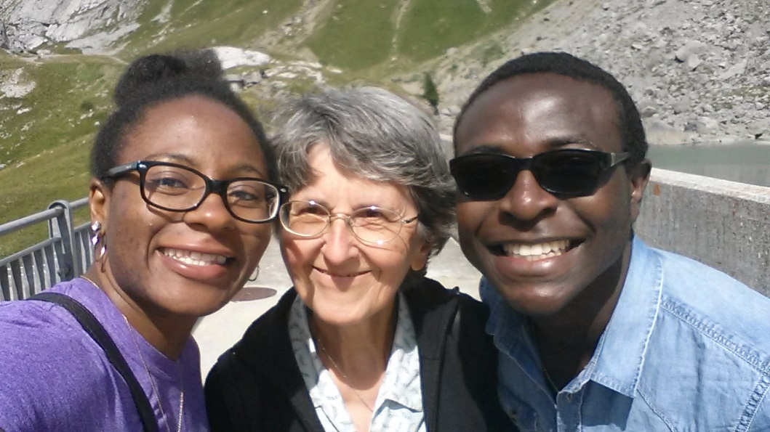
FRIENDS AND FAMILY

Slide 12
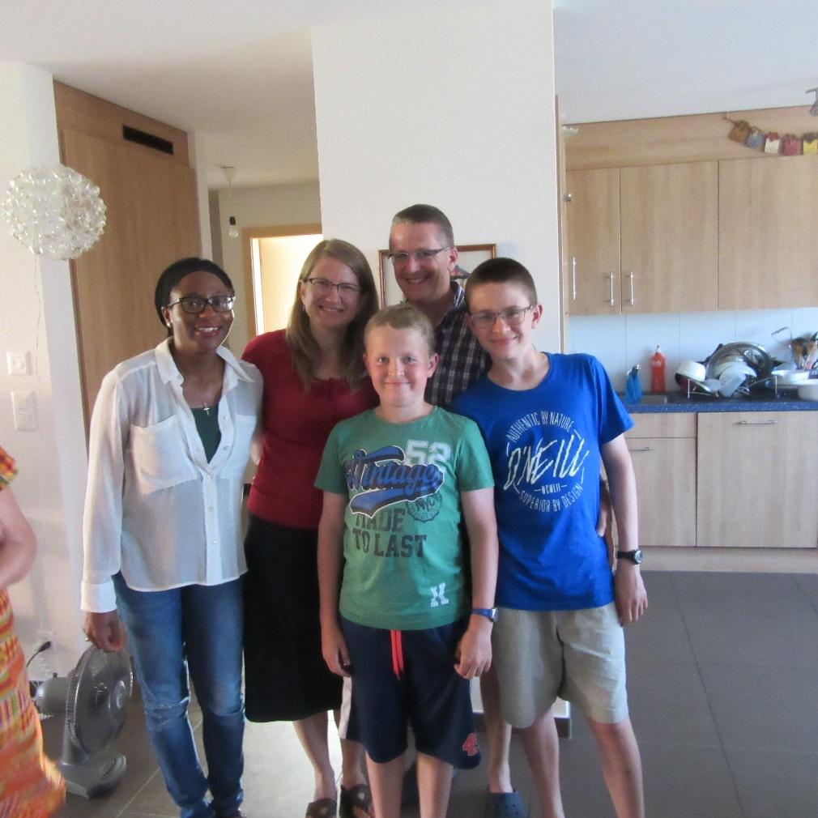
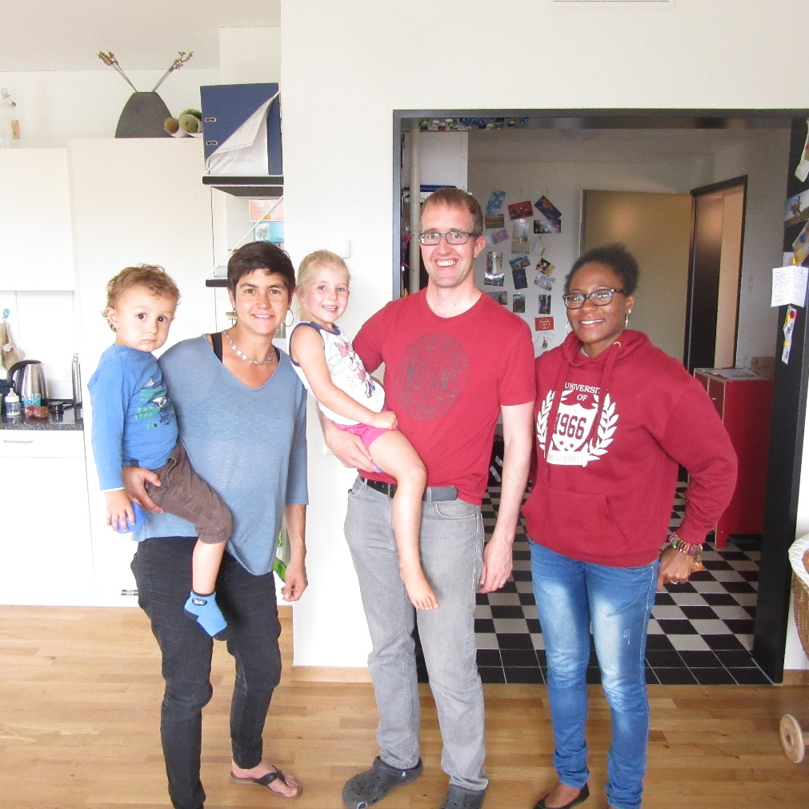
OLD FRIENDS

Slide 13
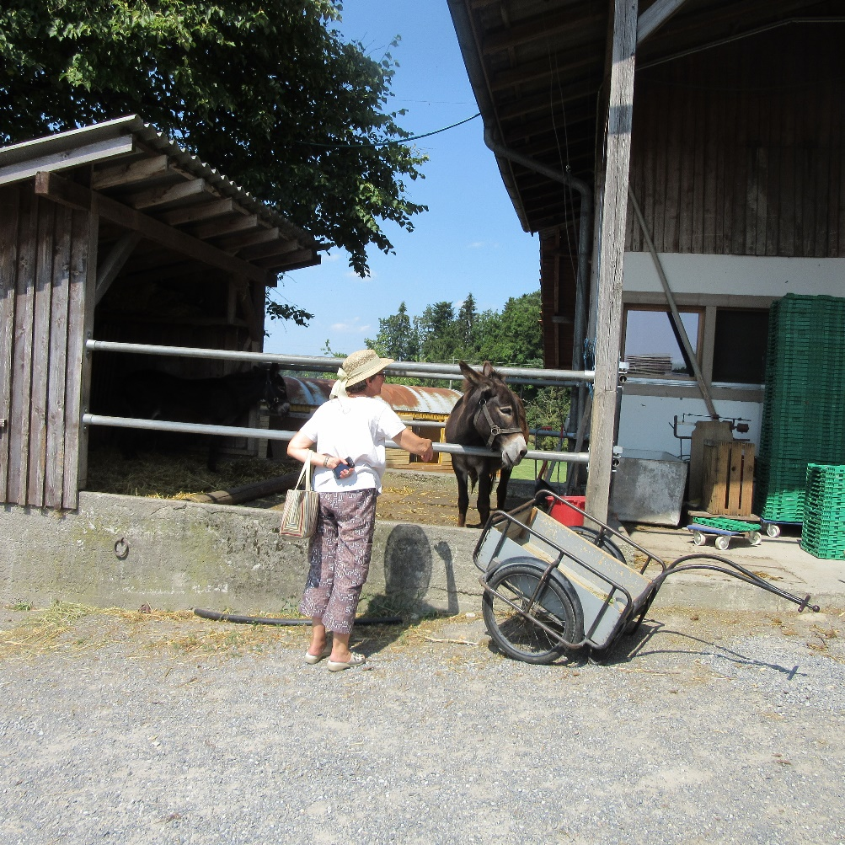
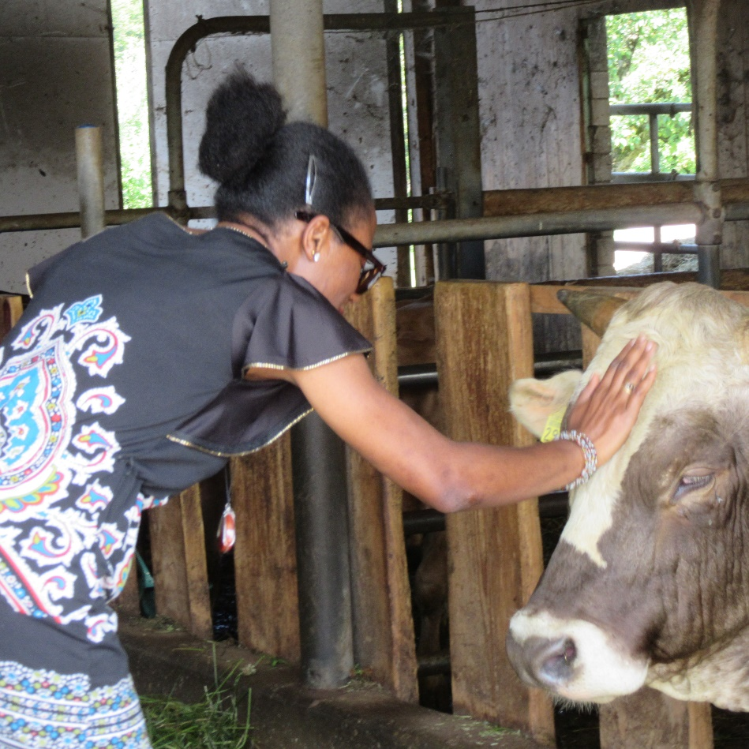
How often do we try new things?

Slide 14
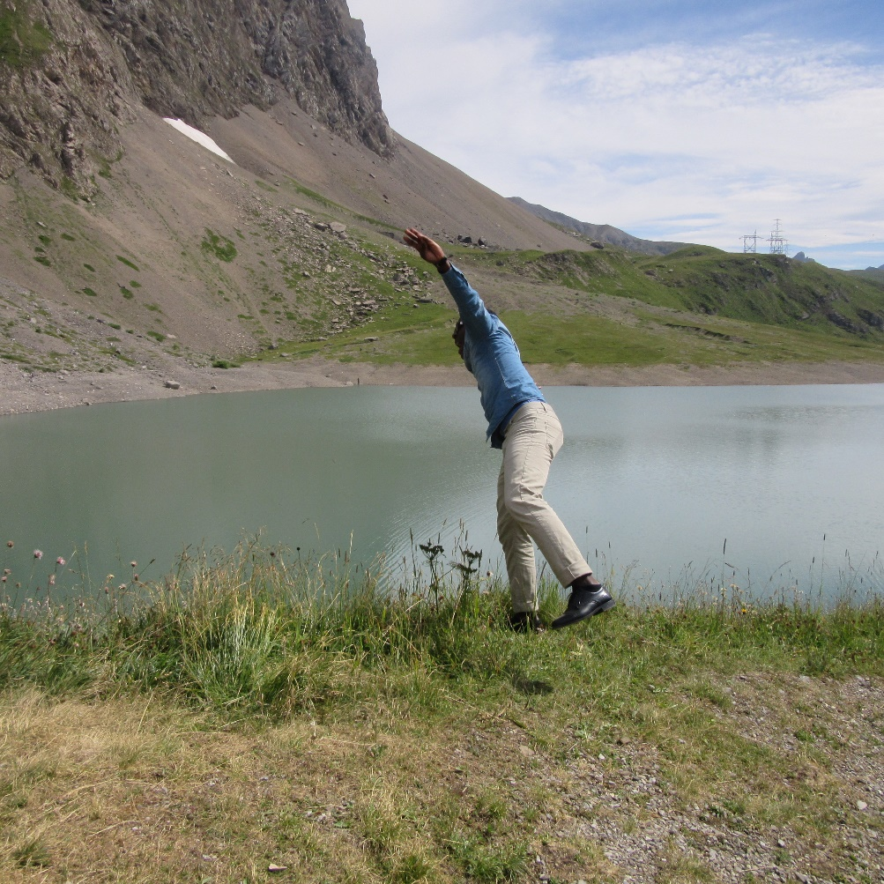
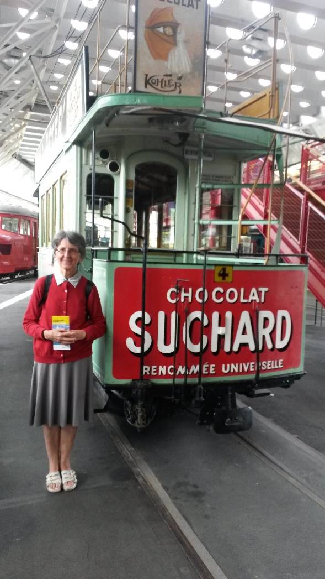
HEHEHEHEHE

Slide 15
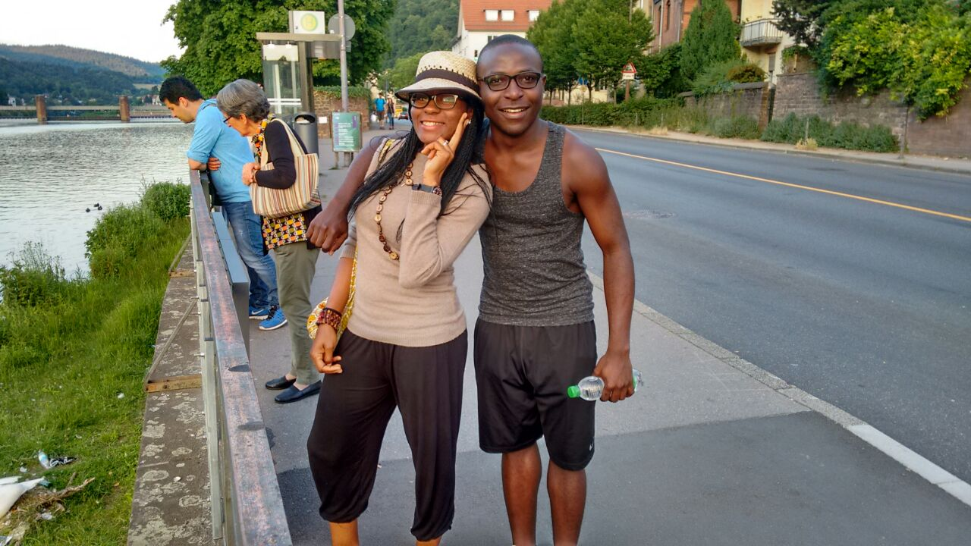
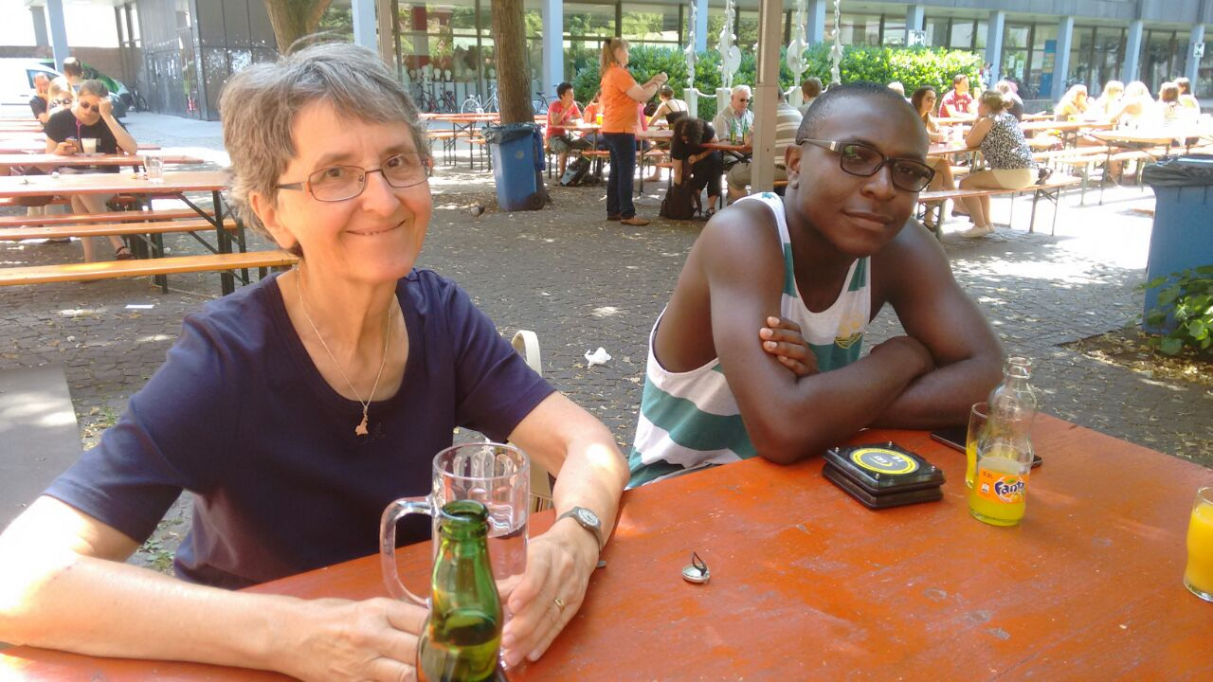
HIDELBERG, GERMANY

Slide 16
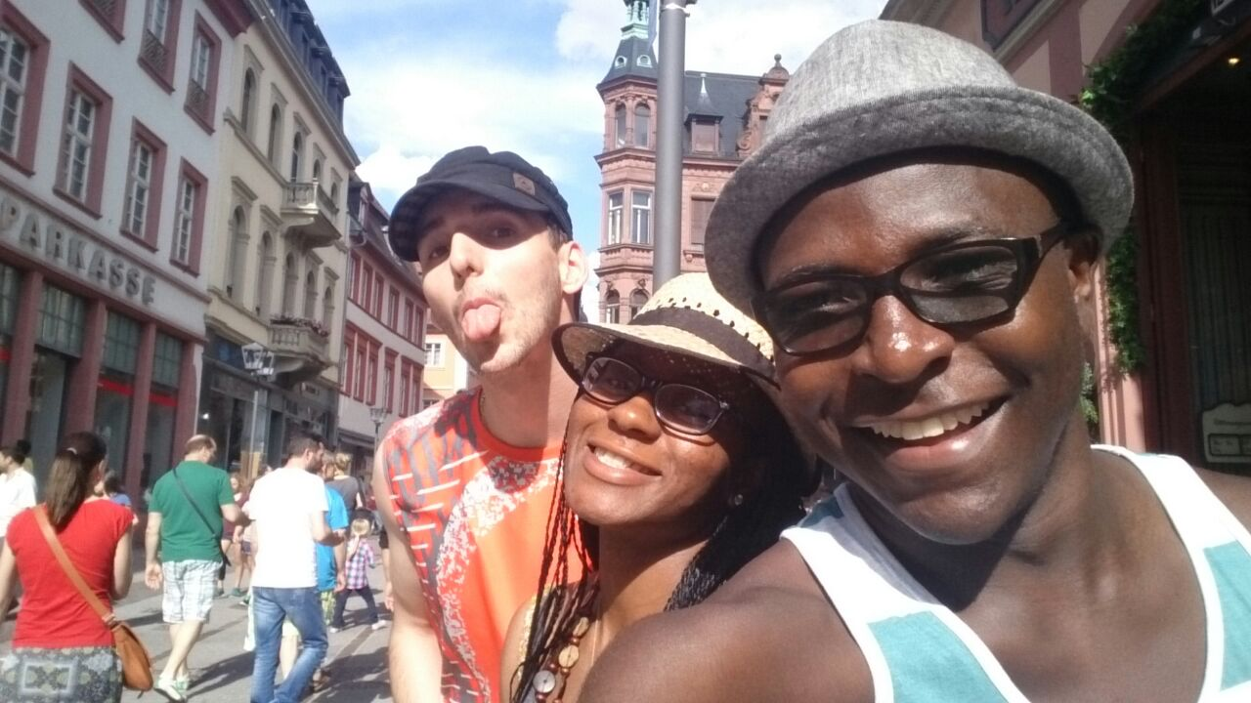
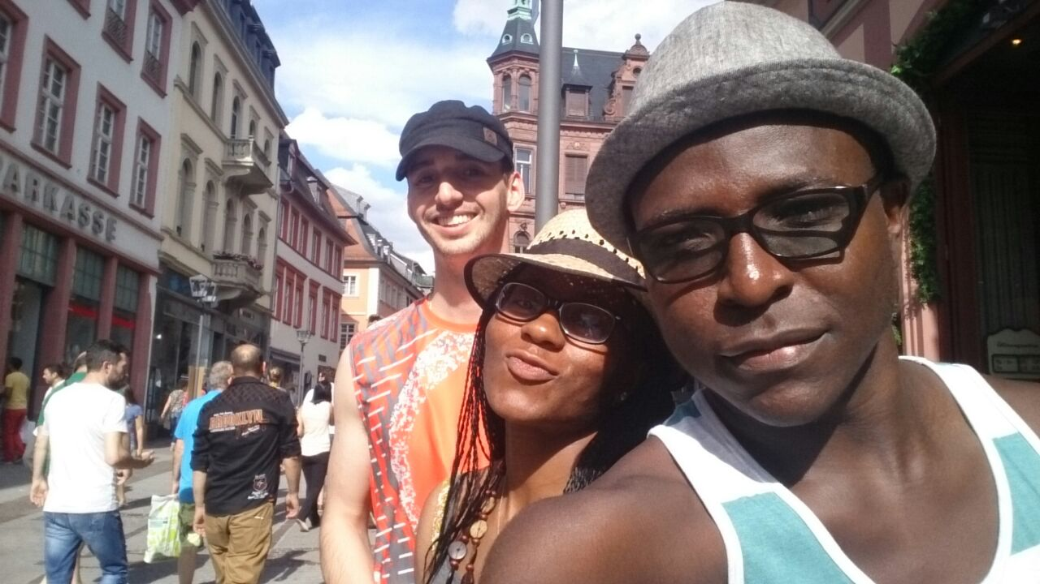
GREAT ADVENTURES
JOFFREY, ME, JOEL
ENJOY

Slide 17
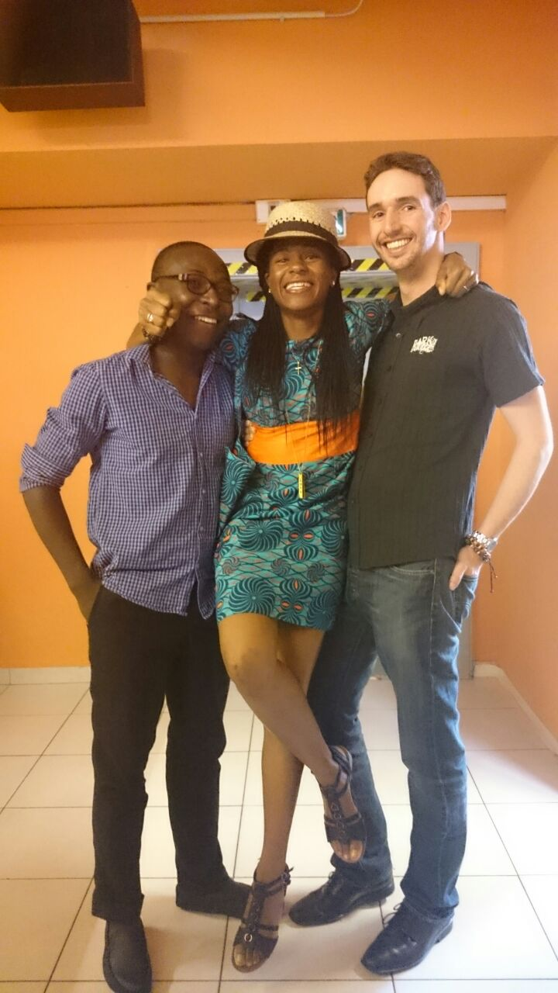
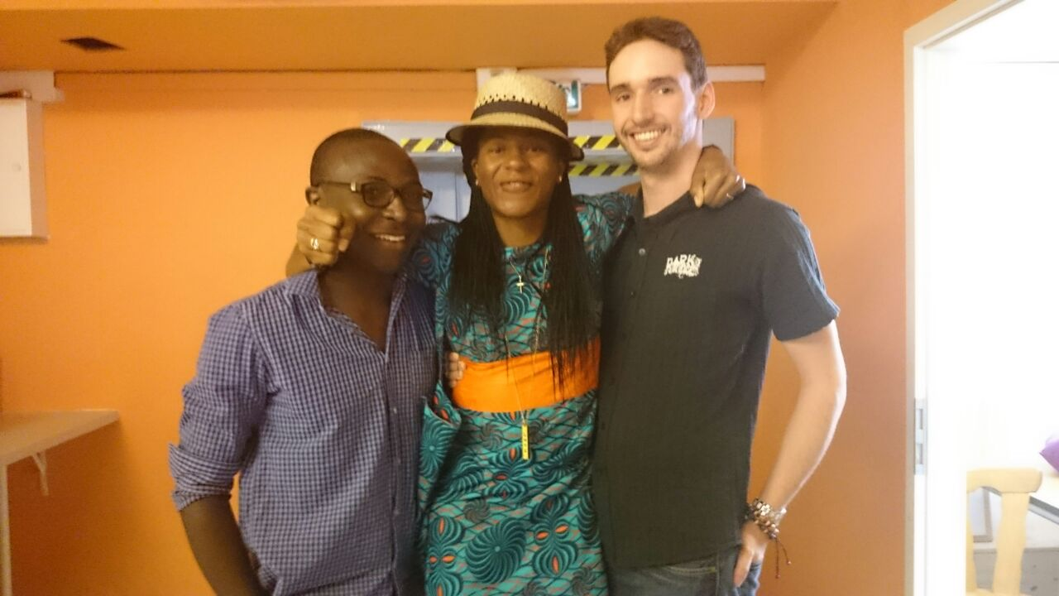
CHURCH AND PHOTOSHOOT

Slide 18
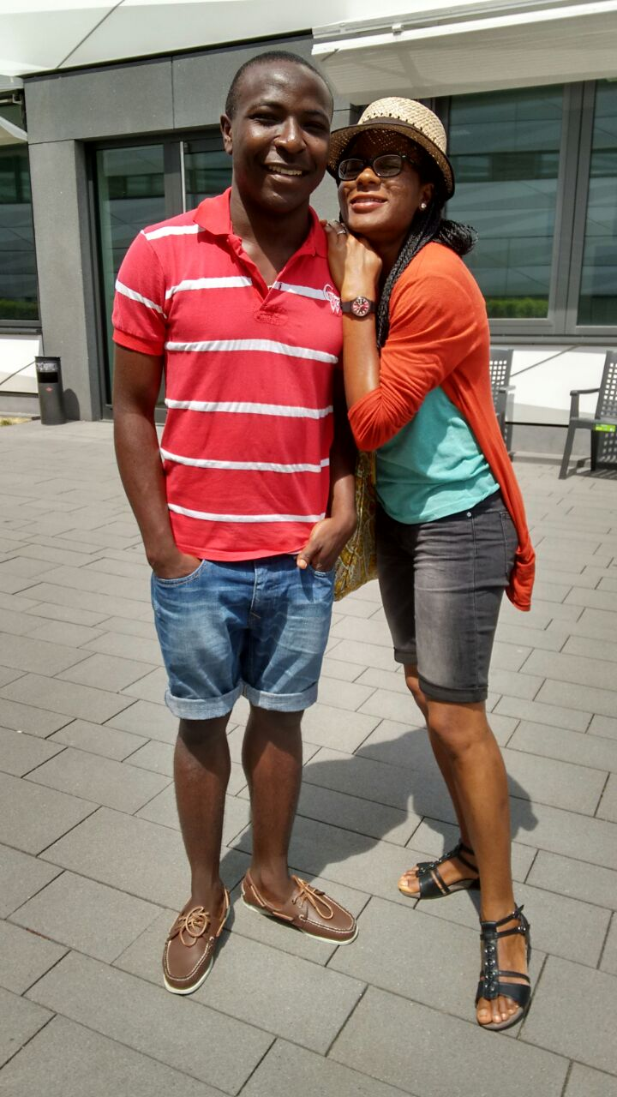
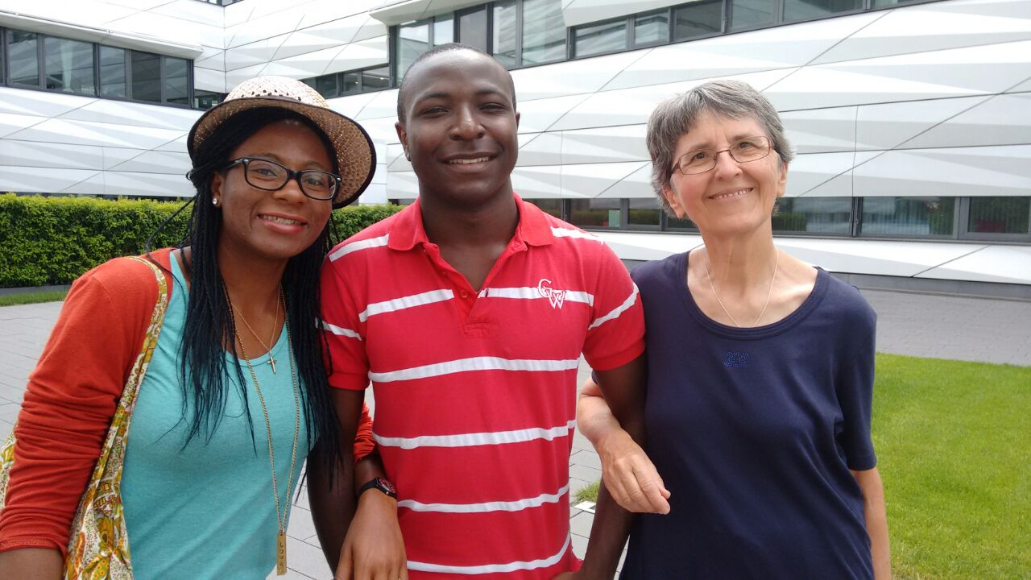
ENJOYED MY GRANDMA AND MY LITTLE BRO

Slide 19
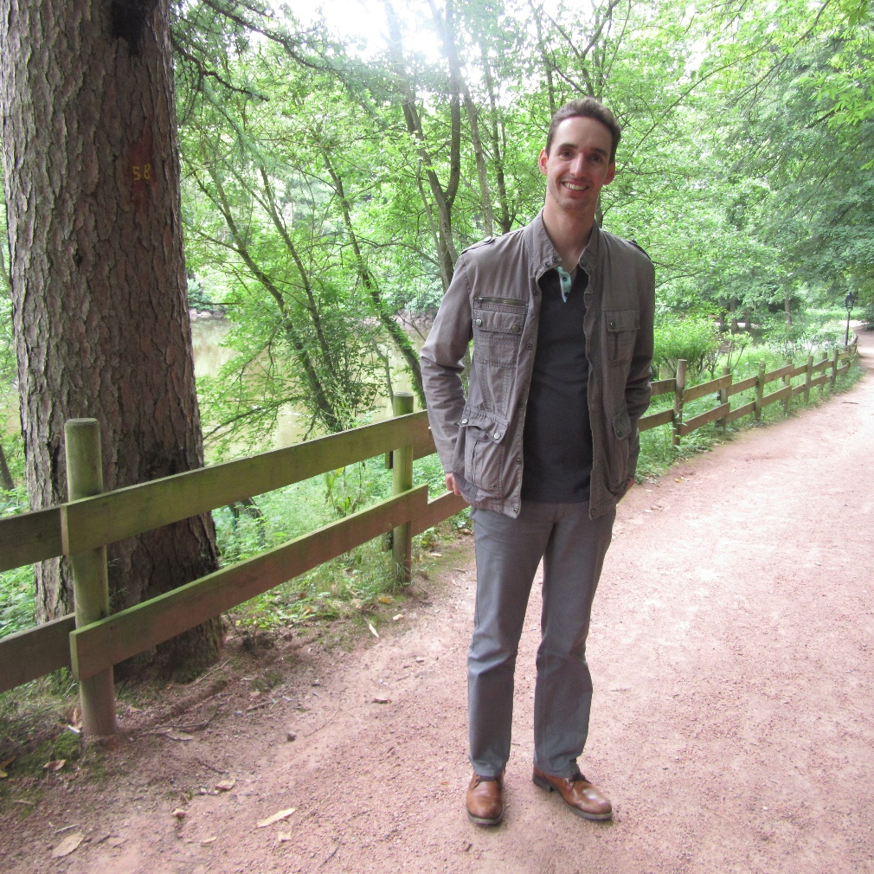
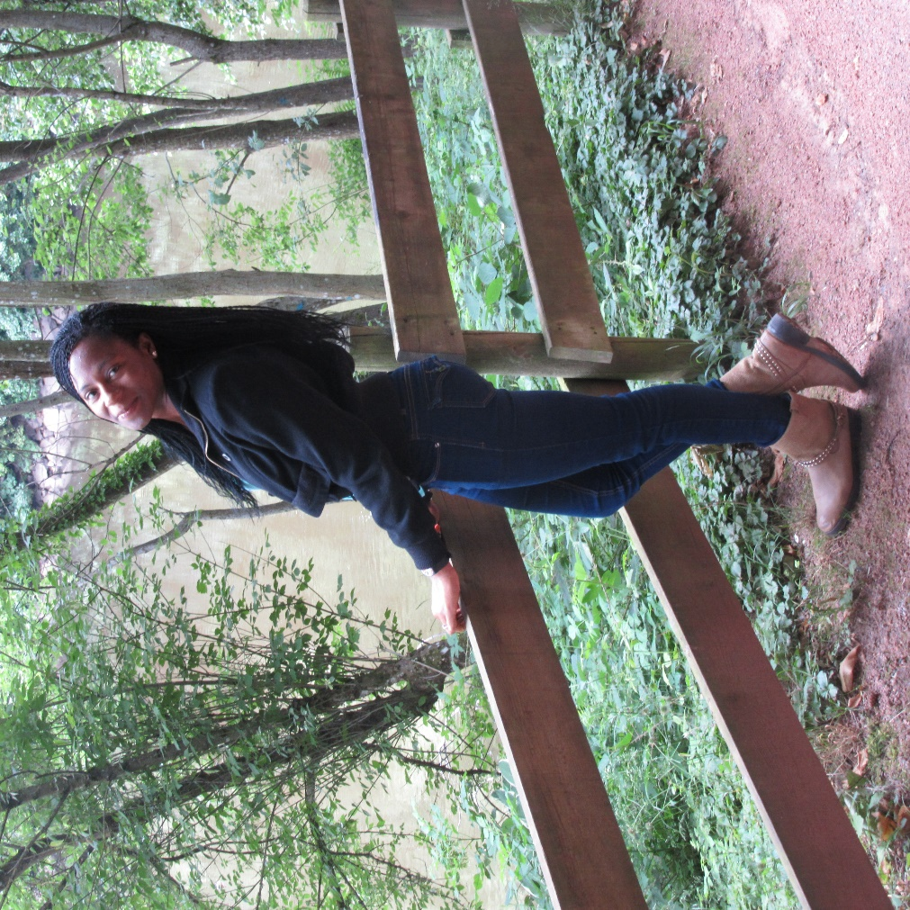
FRANCE

Slide 20
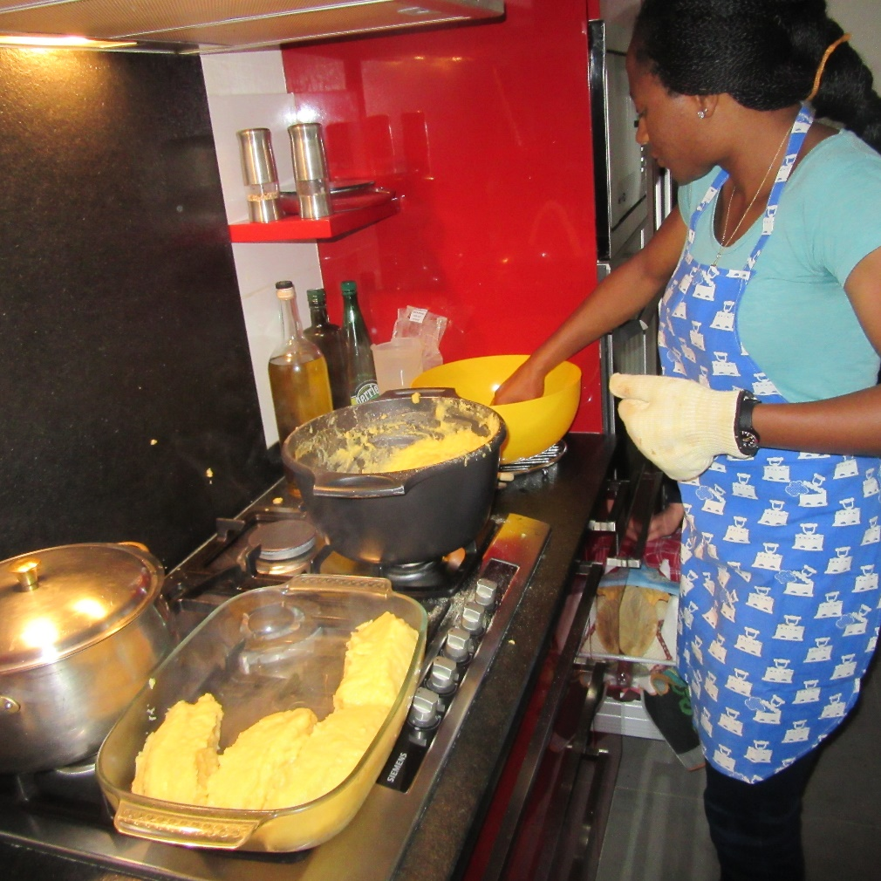
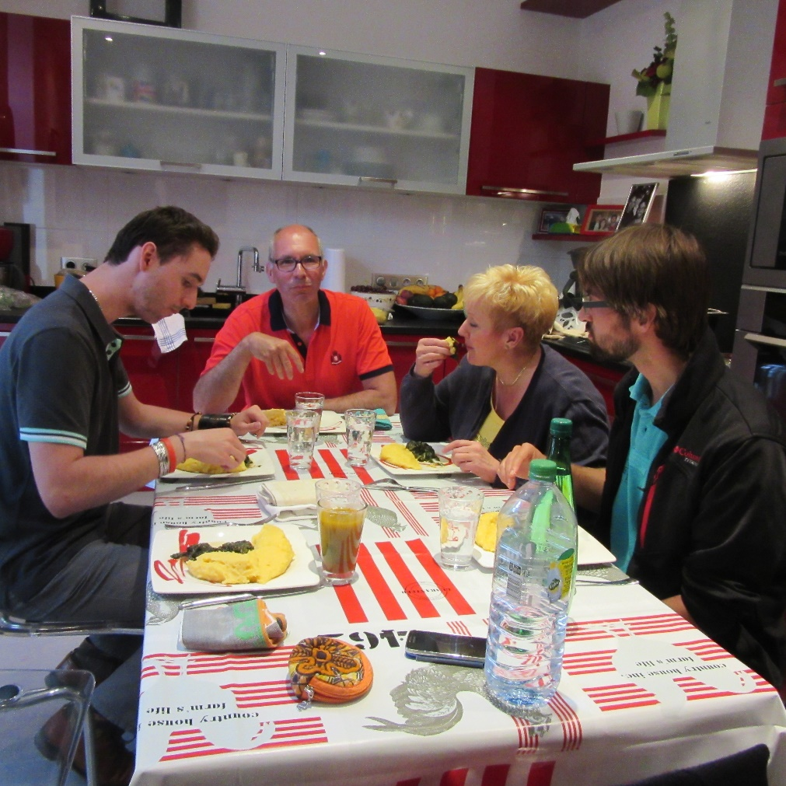
FOUFOU AND SPINISH

Slide 21
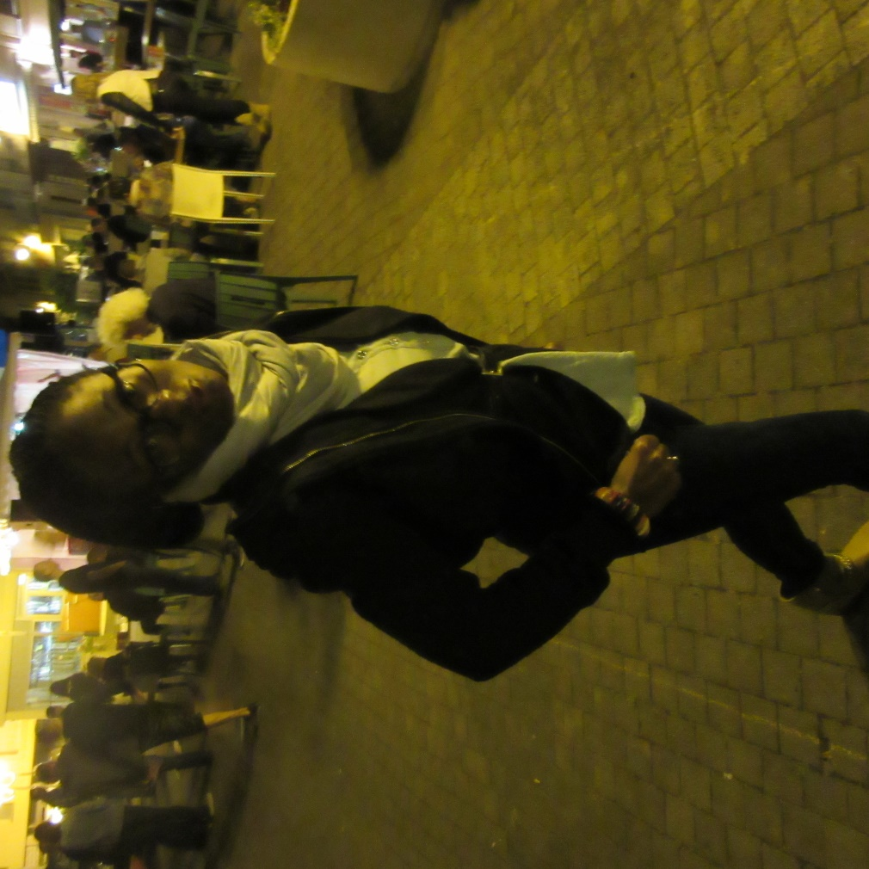
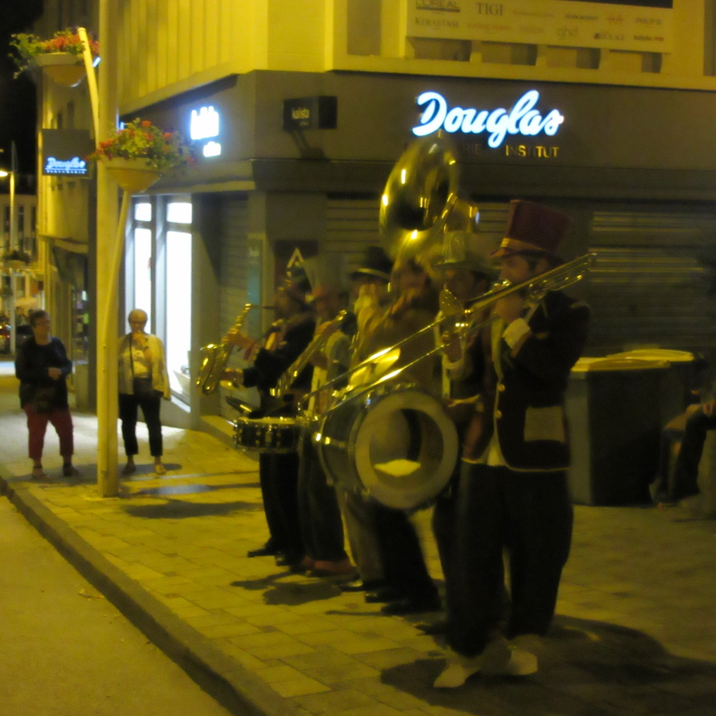
FETE DE MUSIC

Slide 22
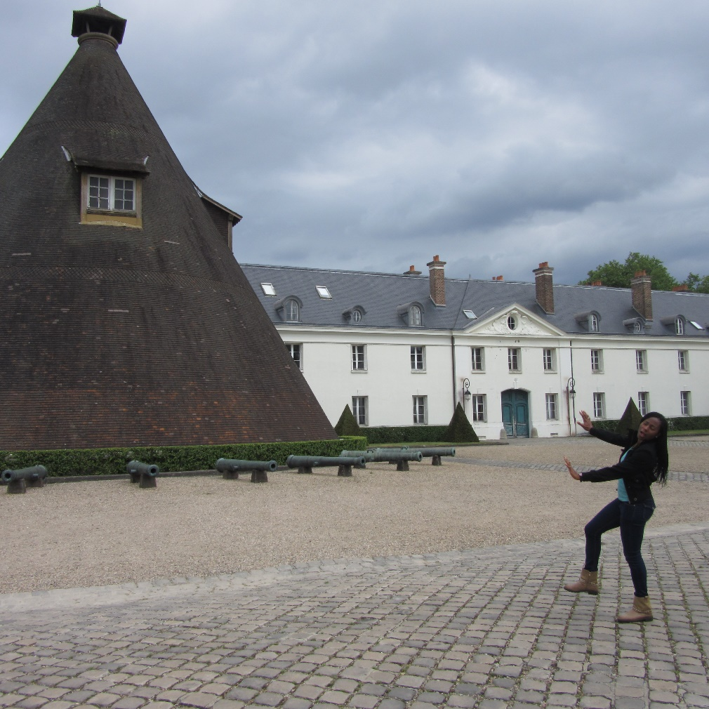
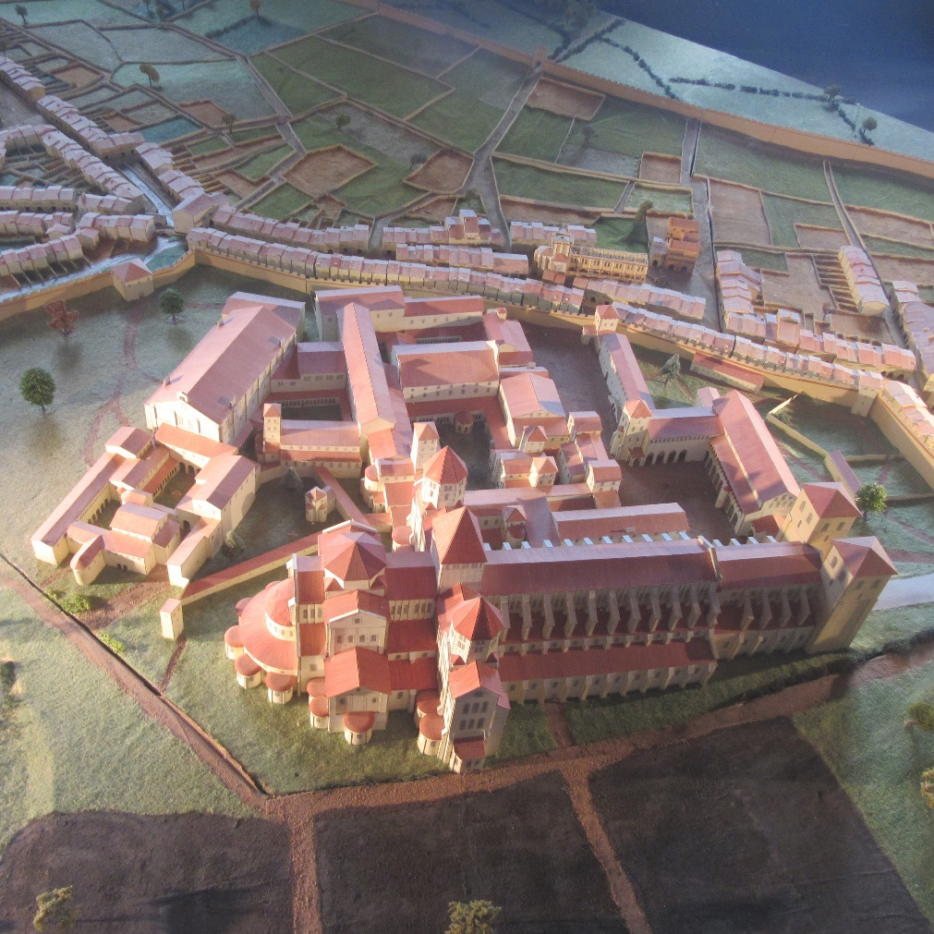
HISTORICAL SITES

Slide 23
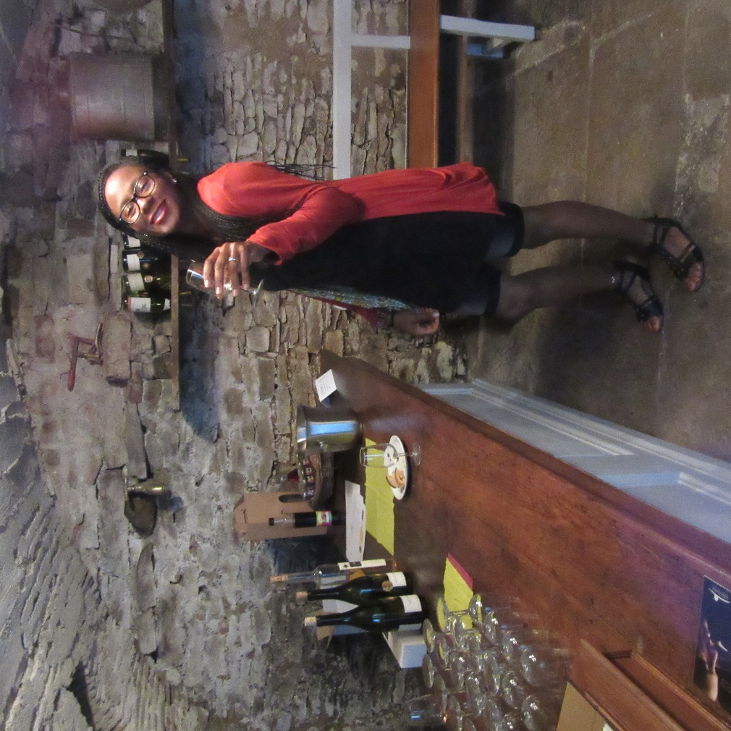
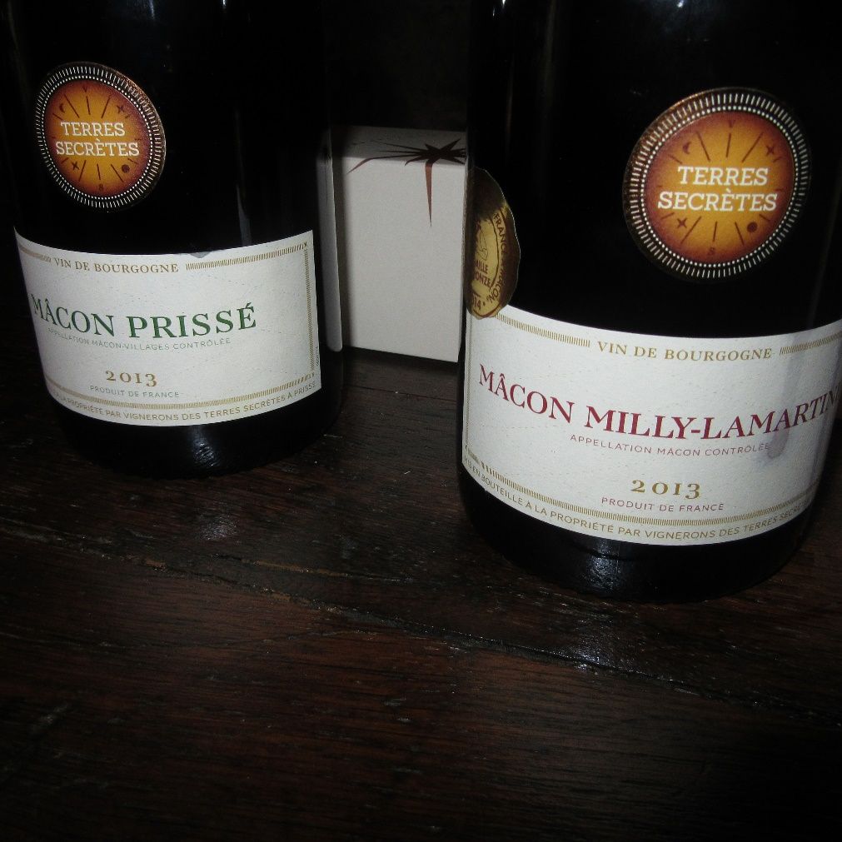
TESTING WINE (VIN DEGUSTATION)

Slide 24
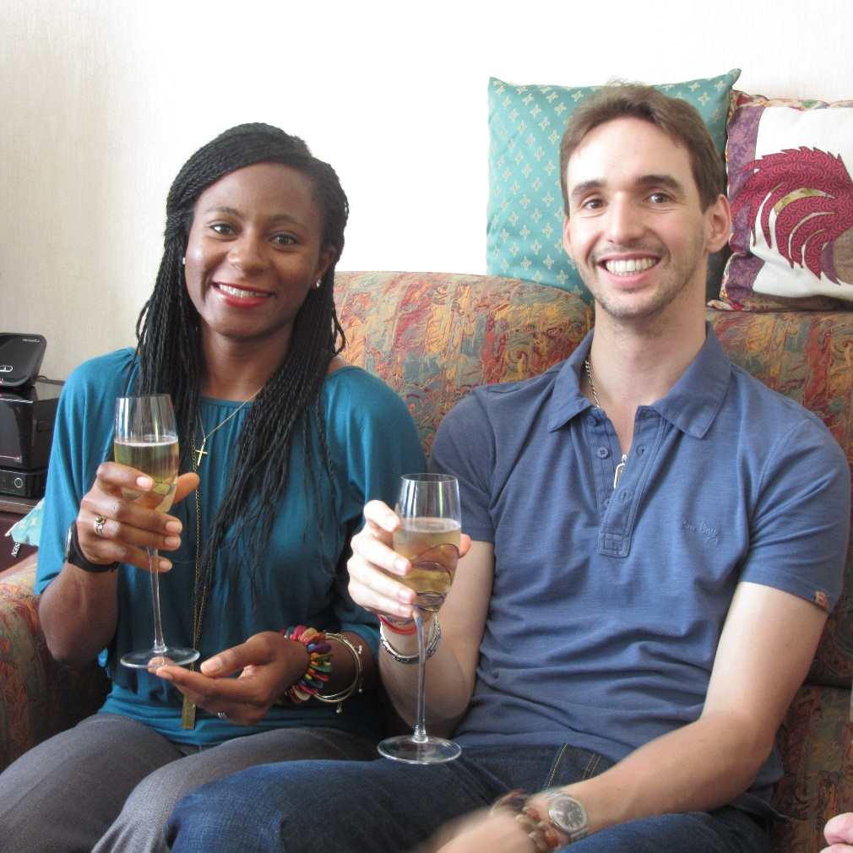
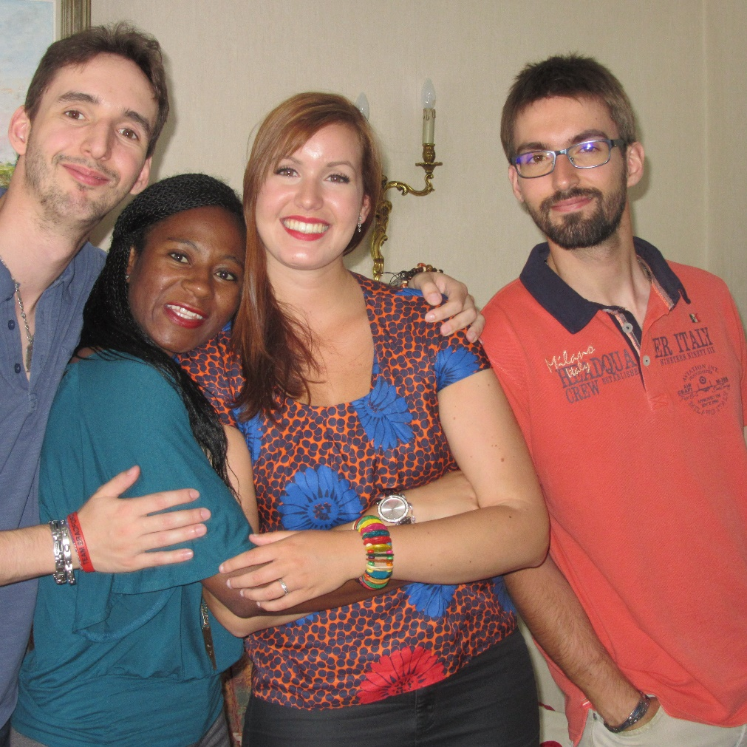
GREAT DAY WITH JOFFREY’S FAMILY

Slide 25
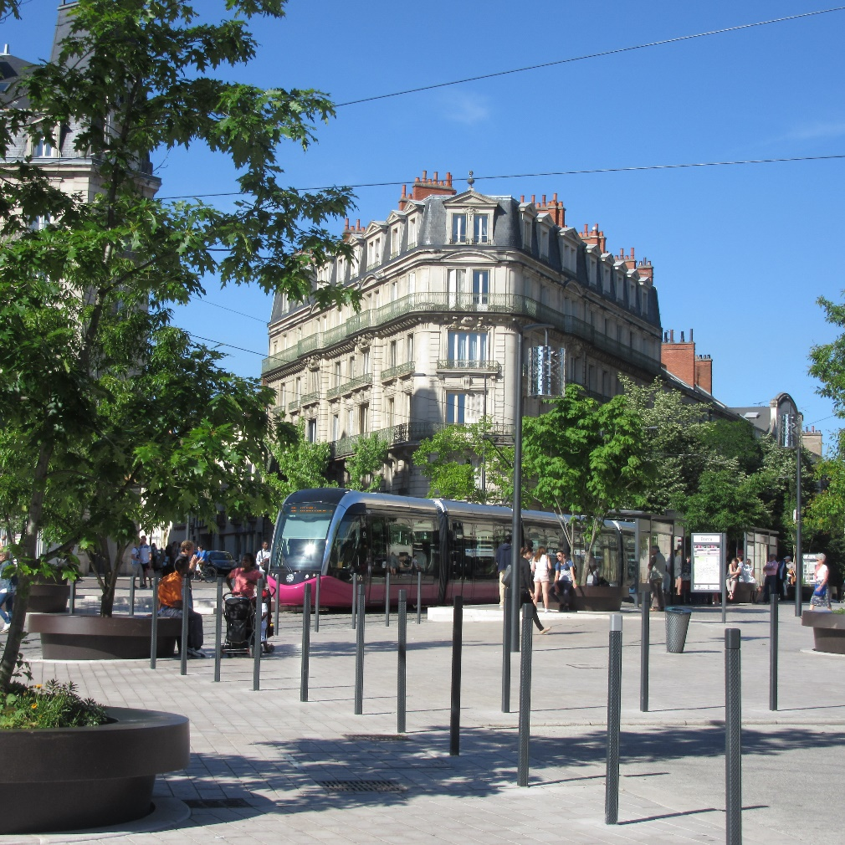
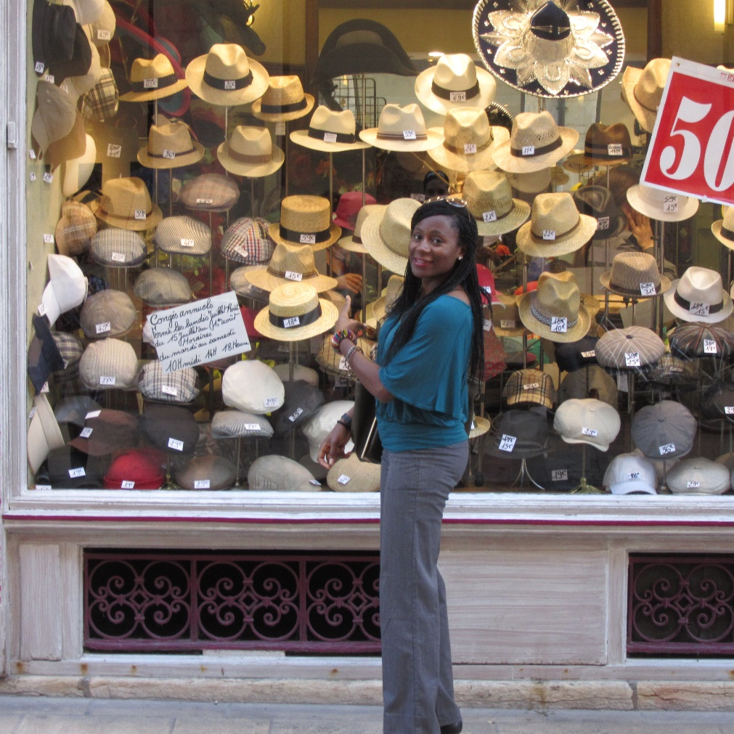
HATS CAN NEVER BE ENOUGH

Slide 26
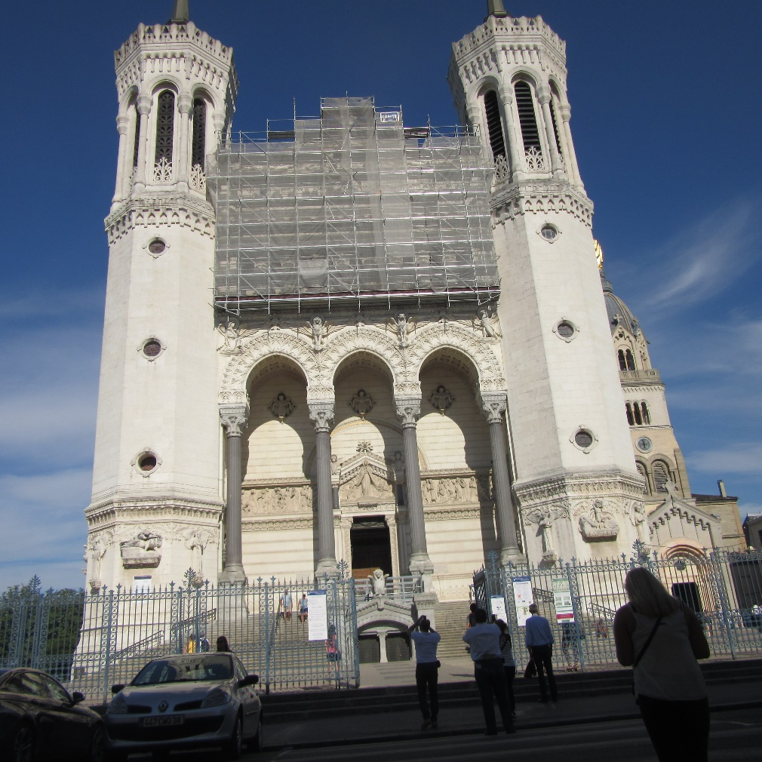
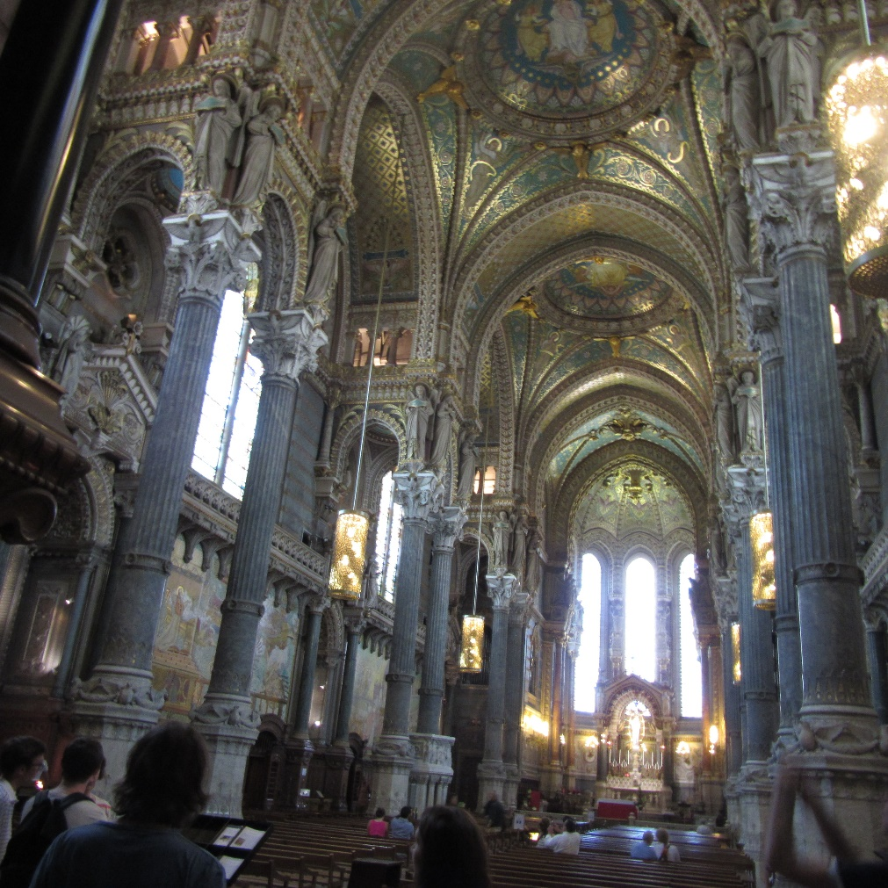
CHURCHES

Slide 27
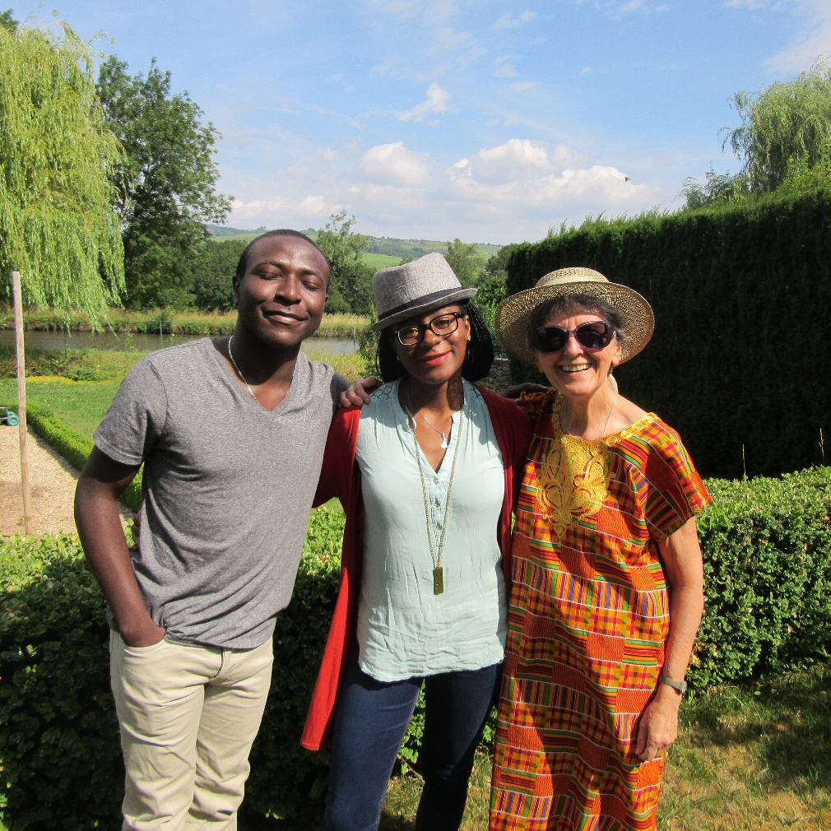

GREAT SATURDAY WITH JOFFREY’S FAMILY

Slide 28


THERE ARE SOME HIDDEN TALENTS

Slide 29


FUN MOMENTS WITH HIS SIBLINGS

Slide 30


HOW CAN WE FORGET TO BE GOOFY?

Slide 31


GOOFINESS NEVER ENDS

Slide 32


SOME OF THE BEAUTIFUL MOMENTS

Slide 33


DEMODOSOLA (ITALY)

Slide 34


MARKET DAY IN DEMODOSOLA

Slide 35


LORCANO (SWITZERLAND)

Slide 36


LAST SELFIES AND GOODBYE

Slide 37
YOUR ADVENTURES ARE UNIQUE
CHERISH EVERY MOMENT YOU MAKE WITH FRIENDS AND FAMILIES FOR TIME LOST IS NEVER REGAINED
Find out more at the PowerPoint Getting Started Center
(Click the arrow when in Slide Show mode)
Notes:
In Slide Show mode, click the arrow to enter the PowerPoint Getting Started Center.

